Slide 1
Building iOS Swift apps
5030-201720_MCS5993_M: 5030-Topics in Computer Science
5031-201720_MCS4993_M: 5031-Topics in MA/CS

Slide 2
Agenda
Leftovers
Apple Watch

Slide 4
Notes:
Run it on a simulator

Slide 5
Downloading files onto watch directly
Notes:
Use URLSession as you would on a phone, but with more consideration toward resources and the size of the file you are downloading.
Always consider whether or not you need the file immediately. If you need the file and the size is quite manageable, download it on the watch itself. If the file is big, try to download it on the companion app on the iOS device first and then send the file over to the watch, which itself takes some time.

Slide 6
Notes:
Place a label and a button on your interface
Make sure the label can contain at least four lines of text (see Figure 7-4).

Slide 7
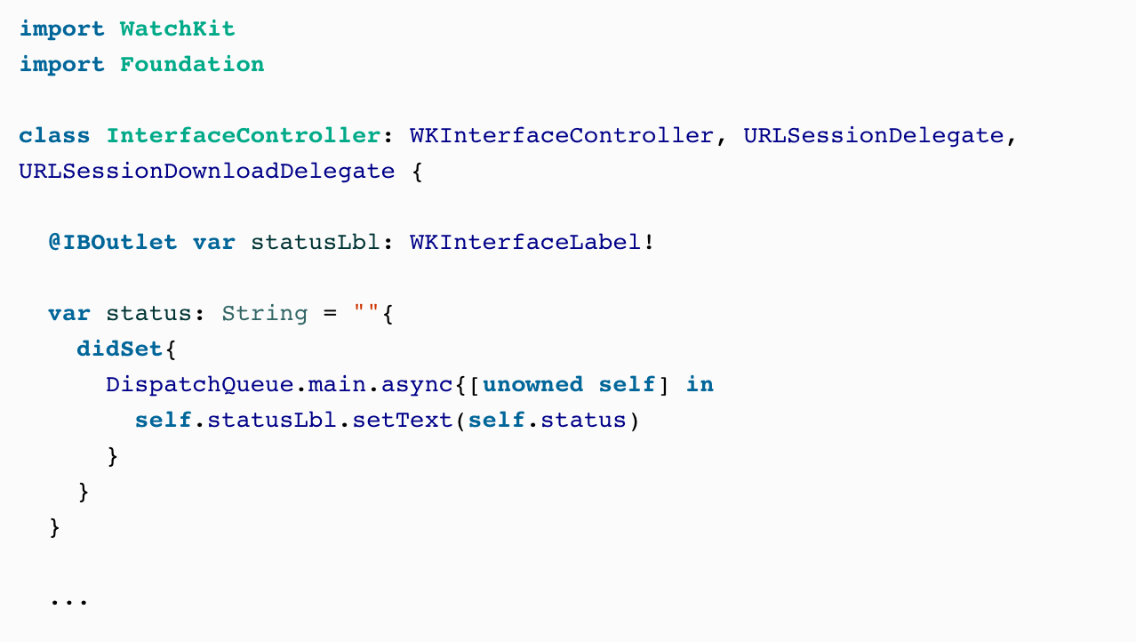
Notes:
Hook up your button’s action to a method in your code named download. Also hook up your label to code under the name statusLbl.
URLSession delegate methods get called on private queues (not the main thread), so I’ve coded a property on our class called status. This is a string property that allows us to set the value of our label—always on the main thread—regardless of where this property gets set from, since UI work (including changing a label’s text) can only be performed on the main thread.

Slide 8
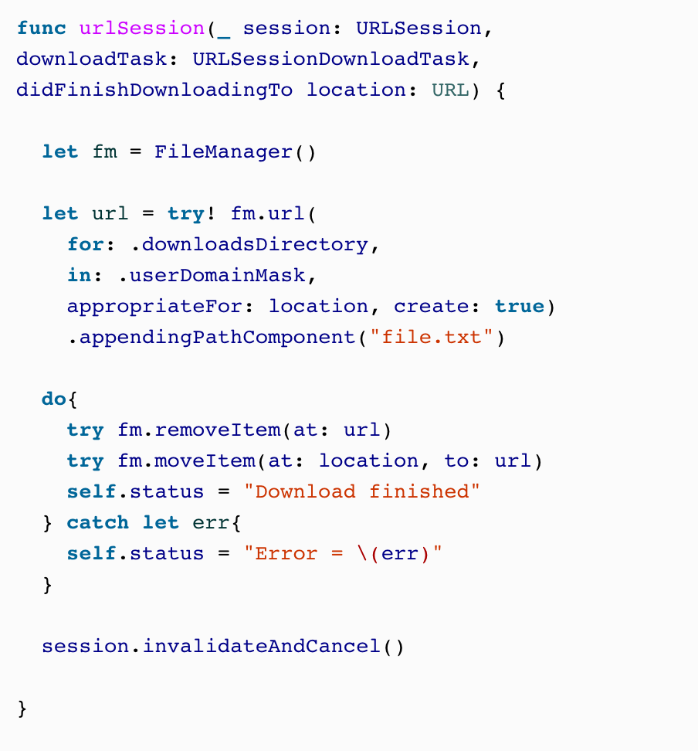
Notes:
The most important method of the URLSessionDownloadDelegate protocol that we are going to have to implement is the URLSession(_:downloadTask:didFinishDownloadingToURL:) method. It gets called when our file has been downloaded into a URL onto the disk, accessible to the watch. The file there is temporary: when this method returns, the file will be deleted by watchOS. In this method, you can do two things:
Read the file directly from the given URL. If you do so, you have to do the reading on a separate thread so that you won’t block URLSession’s private queue.
Move the file using FileManager to another location that is accessible to your extension and then read it later.
We are going to move this file to a location that will later be accessible to our app:
You can see that we also have to call the invalidateAndCancel() method on our task so that we can reuse the same task identifier later. If you don’t do this, the next time you tap the button to redownload the item you won’t be able to.

Slide 9
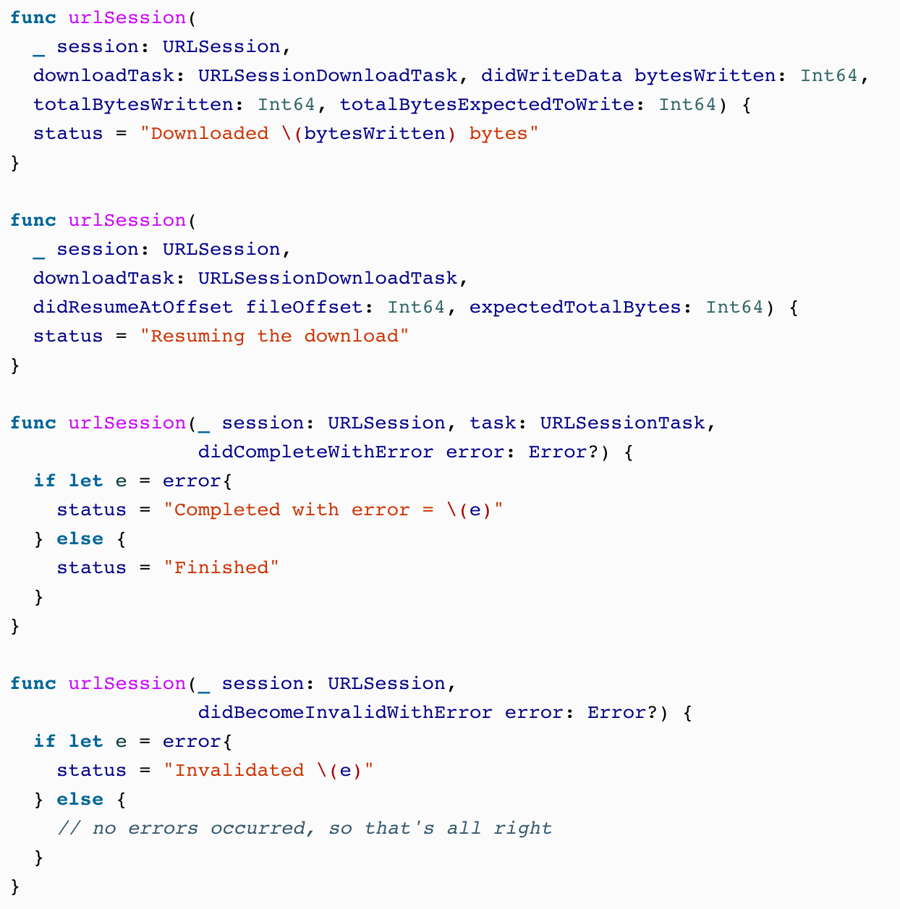
Notes:
We will then implement a few more useful methods from URLSessionDelegate and URLSessionDownloadDelegate just so we can show relevant status messages to the user as we are downloading the file:

Slide 10

Notes:
FIX THIS WITH A GOOD FILE NAME

Slide 11
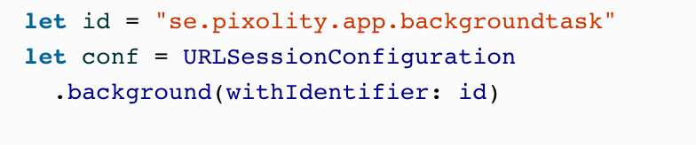
Notes:
Then use the backgroundSessionConfigurationWithIdentifier(_:) class method of URLSessionConfiguration to create a background URL configuration that you can use with URLSession:

Slide 12
Notes:
Once all of that is done, you can go ahead and create a download task and start it (see Figure 7-5):

Slide 13
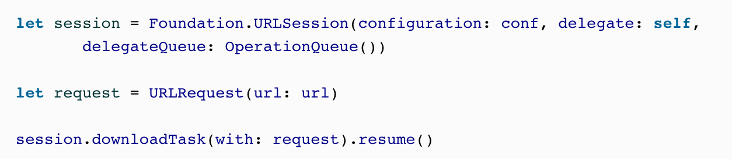
Notes:
Once all of that is done, you can go ahead and create a download task and start it (see Figure 7-5):

